Slide 1
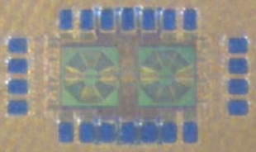
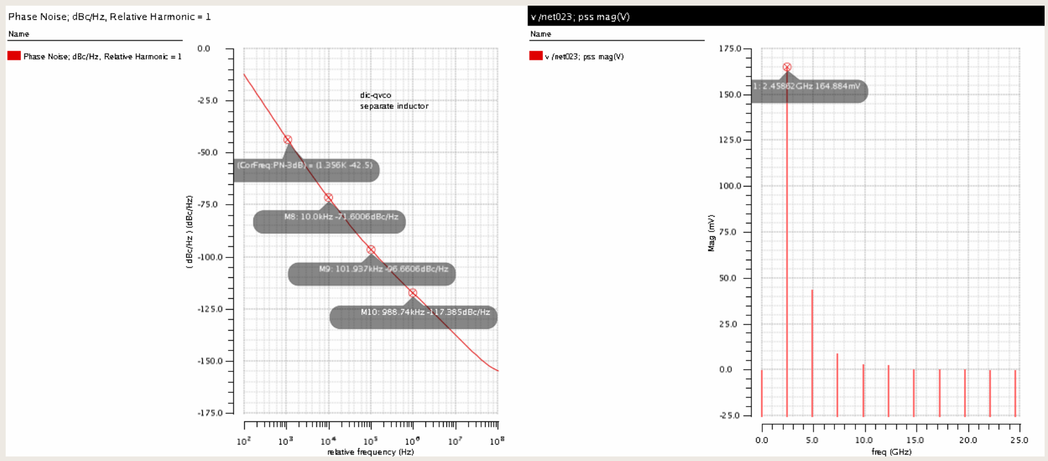
Components for a Sub-Terahertz Detection in 65-nm CMOS
Juhye SHIN, Seung Han HAN* and Dongha SHIM
Department of MSDE, SeoulTech, Seoul 01811, Korea
*Hyundai Robotics, Korea
E-mail : dongha@seoultech.ac.kr
INTRODUCTION
Components for a sub-THz (sub-terahertz) detector are demonstrated in 65-nm CMOS process.
Wideband Slot Bow-tie Antenna-coupled PWT; Direct Injection Coupled QVCO; AMOS PWT test structures
Slot Bow-tie Antenna-coupled PWT
Wideband sub-THz slot bow-tie antenna is employed (center frequency of 250 GHz with the bandwidth of 50 GHz)
Two PWT (Plasma Wave Transistors) are connected in parallel between the signal and ground of the antenna
Gate is isolated from DC bias by a silicide-blocked resistor (~30 kohm)
Size of PWT is 60 nm (W) x 0.51 um (L) x 2
The dummy structures of M1-M6 have the size of 0.7x0.7 um² with the density of 25% (Metal density rule)
Direct Injection Coupled QVCO
Employs a direct injection coupling configuration to implement in-phase coupling
Reduce both phase noise and phase error
Size of core NMOS transistor is 60nm/34um (W/L)
Size of the circuit is 1050x600 um²
AMOS PWT test structures
Measured currents are ~15% higher than those of same structures in S65-1502
Clearly shows the increase of the conductance depending on the gate voltage.
Chip Photo
Simulated Phase noise
Schematic
Chip Photo
CONCLUSIONS
Various components for sub-THz detection have been designed and implemented in Samsung 65-nm CMOS process.
Further DC and RF measurements are needed for all test structures.
ACKNOWLEDGEMENT
This work was supported by IDEC MPW (SS65-1603)

